Slide 1
The Secret to Real Magic Earn more money Enjoy more freedom Built great relationships
Notes:
Want us to...

Slide 2
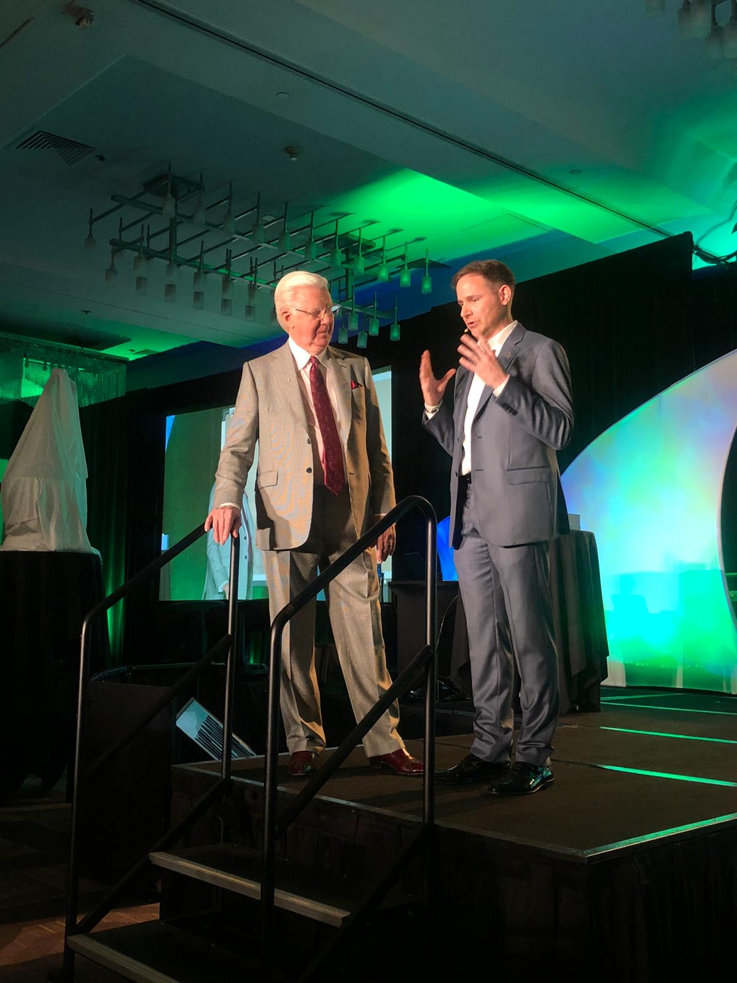
Who are you
20 years as an international illusionist
Performing and producing illusion shows on TV and cruise ships
Realized I was deceiving myself
Moved to the US
Lost everything, broke sick and unhappy
Attracted Bob Proctor into my life
Turned annual income into monthly in 11 months.
Operating a global, multi-million dollar business helping thousands live happier healthier and wealthier lives

Slide 3
Direct solution
We work with people to overcome their self-limiting mental illusions so they can create the time/money freedom they desire.

Slide 4
Agreeable statement
“It is a well-known fact, that only about 95-98% of the population get to live the life they truly WANT to live…”
Notes:
“You probably already know…”

Slide 5
Challenge holding them back
“The problem is, that we have not been taught how to address the main-cause of results in life, our deep-rooted subconscious conditioning…”
Notes:
The challenges they face trying to overcome their problem
If they’re not desperate for a solution… slightly agitate pain

Slide 6
Solution Explained (short and direct)
“However, luckily the program The Secret to Real Magic that Bob Proctor and I have co-created, is based on natural law AND main causes in a persons life…”
Notes:
Whatever the solution is - My super secret leadgen system 900… and here’s how it will help you:

Slide 7
Benefits of the solution:
It’s the best method we’ve discovered to:
Increase and multiply your income
Create a balanced life of freedom
Improve your self-image and self-worth
Obtain and calm and centered mind
Attract your dream-partner

Slide 8
Open Loop
“And I’m going to reveal the details to you in a minute…”

Slide 9
“Because first, I need to explain WHY this works so well”

Slide 10
Reason Why
Explain/Teach a little bit
Avoid back story of how you found it - just talk about why and teach

Slide 11
You are a spiritual being;
You have a marvelous mind; and
You live in a physical body.
1: SPIRITUAL - NON PHYSICAL THOUGHT ENERGY
2: INTELLECTUAL IDEAS
3: PHYSICAL THINGS OR RESULTS

Slide 12
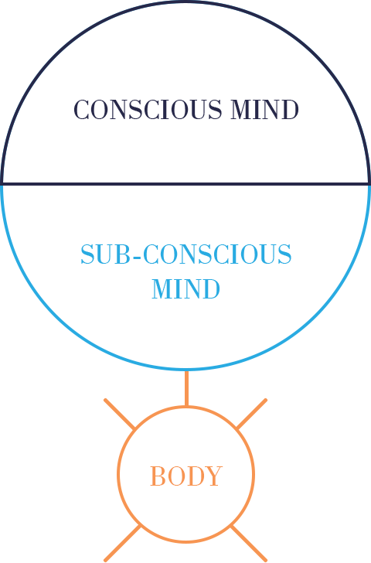
Origin: Dr. Thurman Fleet 1934, as presented by Bob Proctor

Slide 13
40 bits of information per second
20 Million bits of information per second!
Origin: Dr. Thurman Fleet 1934, as presented by Bob Proctor

Slide 14

A paradigm = A mental program which has almost exclusive control over your behavior!
95-98% of your behavior are habits and expressions of your paradigm and NOT your knowledge!

Slide 15
Your Paradigm Controls:
The ability to earn money
Productivity
Logic
Self-Image

Slide 16
Newborn to 5-6 yrs. old:
Emotional mind
Self-Image PARADIGMS
Control actions/DO
Cannot reject anything, MUST accept
Origin: Dr. Thurman Fleet 1934, as presented by Bob Proctor

Slide 17
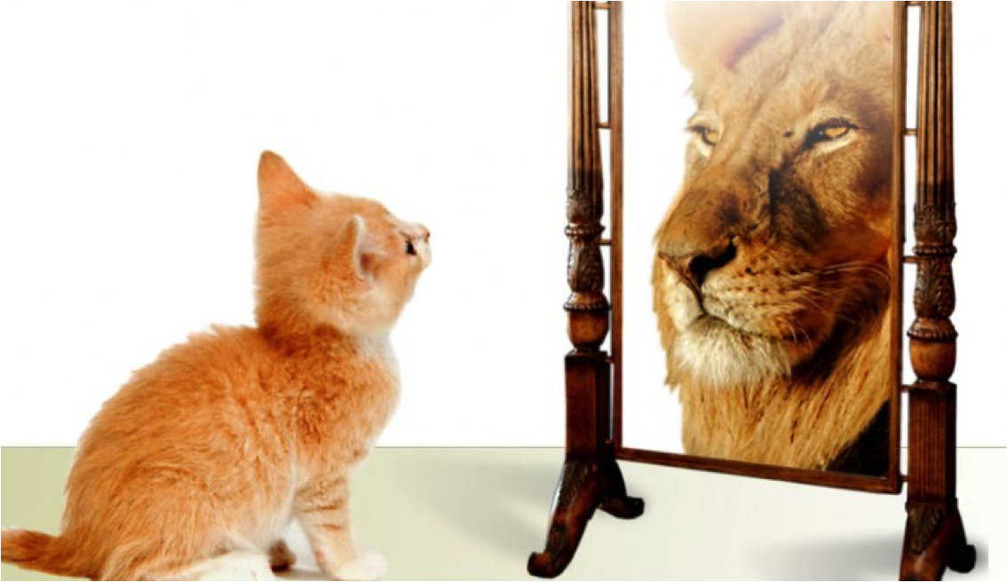
You cannot outperform your self-image, but you can change it!

Slide 18
Step 1 - teach your offer helps phase 1
Changing your deep-rooted subconscious conditioning, is the root cause of results. When they are changed, a persons life is literally transformed. A persons intellect (IQ) is NOT what gives a person their results. It’s their paradigms.
Results of This: A permanent transformation, no more “hoping and wishing”. A guaranteed blueprint for success.
Notes:
Step 1 I’ll help you
Results of this:
<BENEFIT/OUTCOME>

Slide 19
Testimonial/Result
Notes:
Optional slide: testimonial/results of Step 1 - i..e if one of your clients has a breakthrough just htere. Or even just a case study and testimonial in general

Slide 20

”After setting my goal, I used all the tools that Anders introduced me to, to attract my dream job and rid myself of mental patterns that did not serve me. At the same time, I attracted the possibility of deciding my salary. Now I know that the power is within me, to attract exactly what it is I want out of my life.”
-Dorthe Jacobsen
Notes:
Optional slide: testimonial/results of Step 1 - i..e if one of your clients has a breakthrough just htere. Or even just a case study and testimonial in general

Slide 21
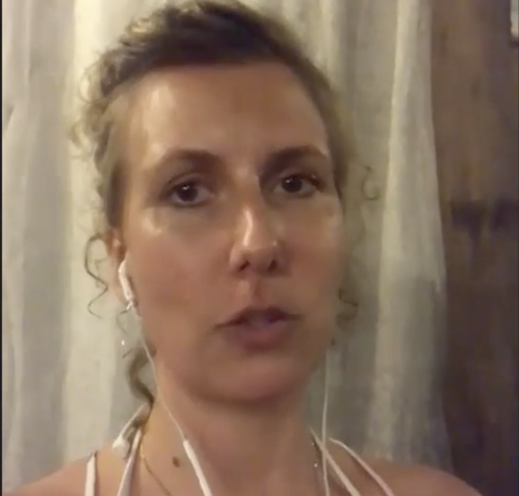
“When I started working with Anders, I suffered from winter depressions which caused my personal life and business to be greatly affected. Today, the depression has been replaced with so much energy that I have a hard time stopping work, and I’ve experienced a quantum leap in my business, hired 2 employees and it hasn’t even been 12 months yet.”
Pernille K.
Notes:
Optional slide: testimonial/results of Step 1 - i..e if one of your clients has a breakthrough just htere. Or even just a case study and testimonial in general

Slide 22
We show you the entire process of how to change your results at the root
Notes:
Wwhen they work with you, you do step #1 FOR THEM… so they save time and all these other benefits

Slide 23
Step 2 - teach a way you’ll help phase 2
Help them override money blocks and build a self-image that is in harmony with the desired results. Results of This:
You feeling worthy of results you want, increase in quality of relationships as well as income is a natural by-product
Notes:
Step 2 I’ll help you
Results of this:
<BENEFIT/OUTCOME>

Slide 24
Want Us To Do ALL Of This For You?
Want us to help you with this?
Then fill out the application on this page.
Then click below and get signed up on this next page

Slide 25
Testimonial/Result

Slide 26

Went from having crippling anxiety for years to becoming an author and speaker in less than 12 months…
Today she is an active participant in life and LOVES it!
Sandra T.

Slide 27
Set a goal of becoming a nationally recognized speaker. After 3 months in the program, Frank is mentioned in national media as one in 5 of the country’s best speakers.
Frank K. (Image is coming)

Slide 28
Step 3 - teach how you’ll help
We are going to teach you the energy behind money and the laws that governs the earnings of it as well as how to multiply it.
Results of This:
Time / money freedom for the rest of your life

Slide 29
Results/Case Studies

Slide 30
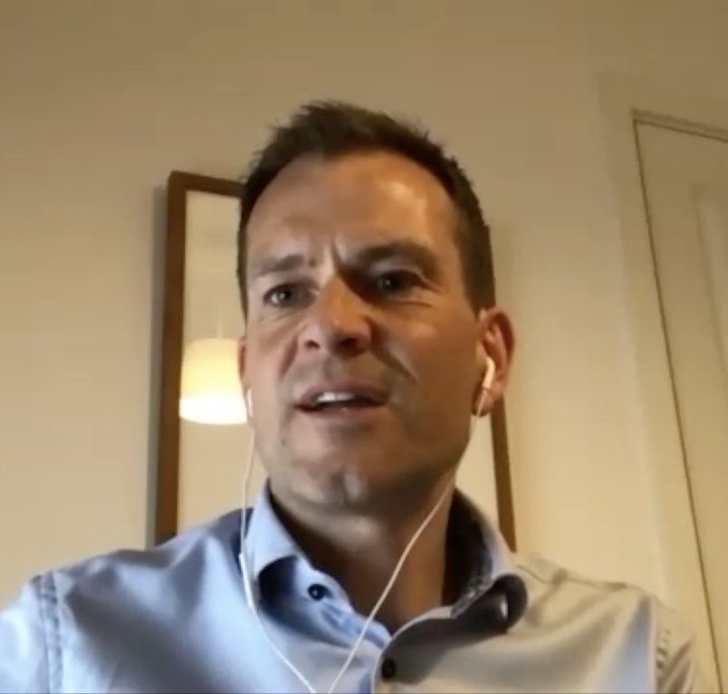
“After 7 years as an entrepreneur, having confusing results, to having earned the same in the last 3 months as I did all of last year combined... It’s a quantum leap and there is more peace and flow and time with the family, more so than ever before. When I look ahead, I know it’s going to be really great!”
Michael C

Slide 31
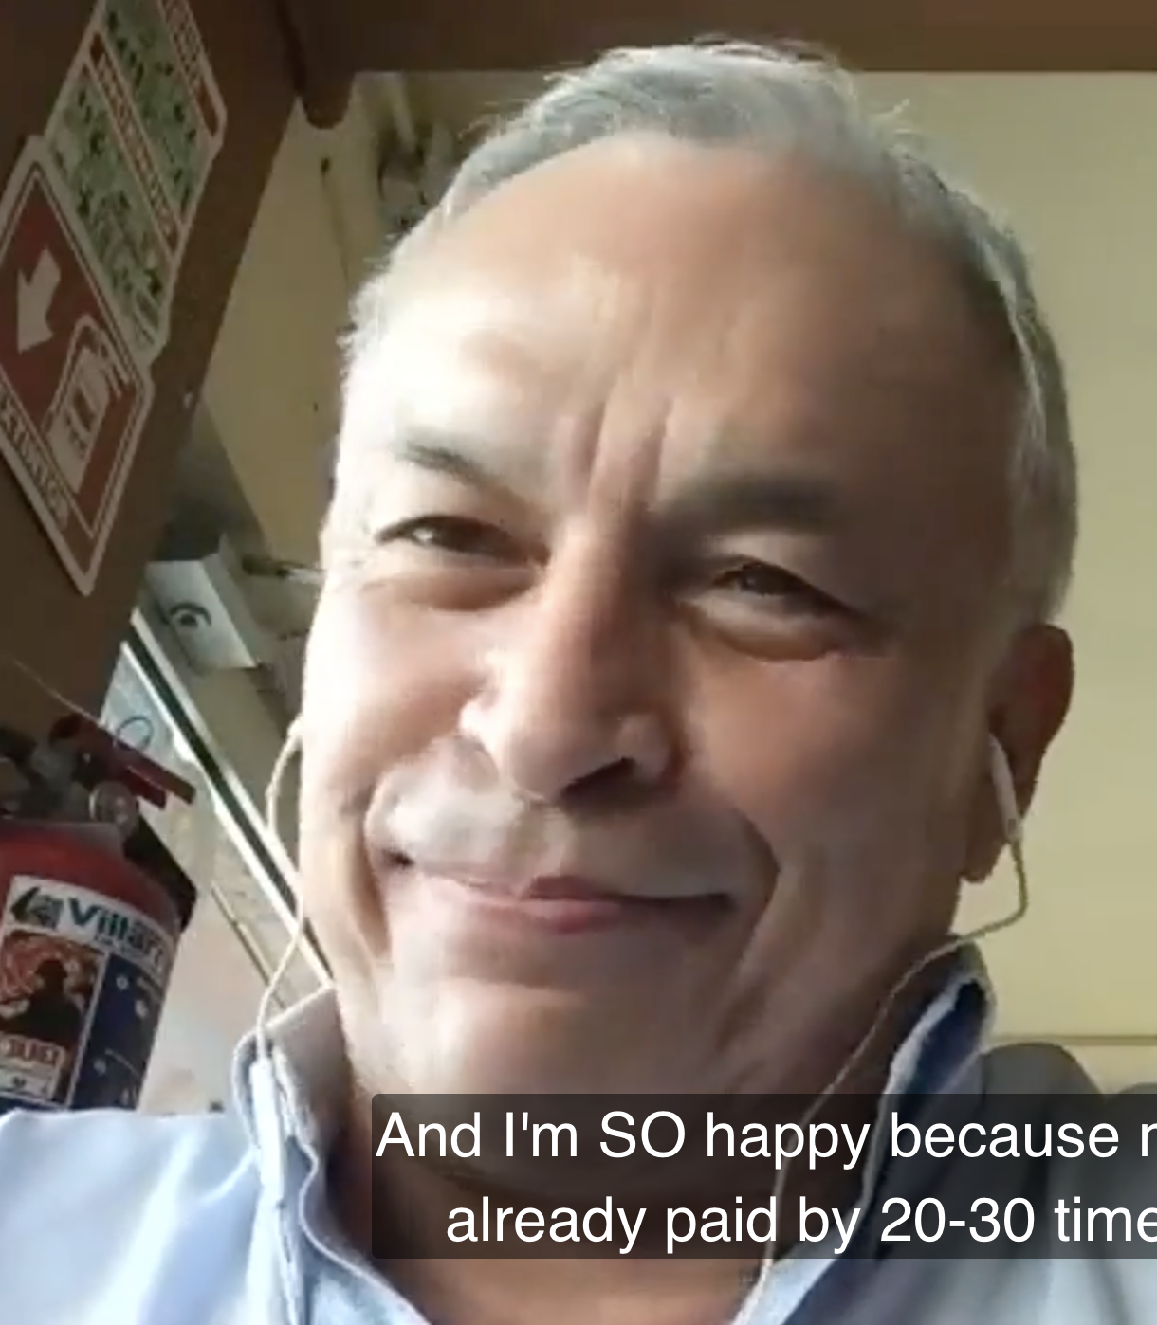
Tripled his sales in the first month after 40 years of stagnant results, rebuilt his house, happy family-life and feels stronger than ever before at age 60.
Octavio Ballesteros
Notes:
Optional slide: testimonial/results of Step 1 - i..e if one of your clients has a breakthrough just htere. Or even just a case study and testimonial in general

Slide 32
How we’ll help you recap
Change your deep—rooted subconscious conditioning (paradigms) for a permanent transformation
Integrate a new self-image that aligns with your goal for winning confidence and improvement in results
Teach you the mental science behind multiplying your income, so that you can life the rest of your life with time and money freedom
Notes:
Very brief. Only one sentence per step

Slide 33
Plus, we’ll even host an entire VIP day for you to deepen your understanding
Notes:
Plus, we’ll even <do THIS for you>

Slide 34
“So, if you want us to help you….”
Change your deep—rooted subconscious conditioning (paradigms) for a permanent transformation
Integrate a new self-image that aligns with your goal for winning confidence and improvement in results
Teach you the mental science behind multiplying your income, so that you can life the rest of your life with time and money freedom
Notes:
So… if you wnat me to

Slide 35
Then fill out the application on this page & schedule a call to speak with our team.
Then press the button below, fill out your info and invest into the product to get started.

Slide 36
When you work with us we will personally:
Facilitate an onboarding call with our team
Send you the start package and 200+ page workbook (shipped with international courier)
Introduce you to our Real Magic Community of likeminded people
Team you up with an accountability partner in the program
Be there to support you every step of the way, making success nothing but inevitable for you
Notes:
If any of this sounds awesome, don’t even think anymore. Just start filling out the application on this page, and get on the phone with us so we can see if we’re both a good fit.

Slide 37
There’s a limited amount of this we’re going to sell, so those who do get in will get the most results

Slide 38
If you’re seeing this video right now that means there’s spots still open
If you’re seeing this video right now, that means there’s still room left

Slide 39
Fill out the application on this page now
Invest in yourself now on the next page, press below to get started

