Slide 1

Webinar Format
This slide template is designed to provide you with a guide for creating your webinar or presentation structure.
This is the formula that I use.
The sections in this slide deck are:
Introduction
Content
Transition
Close

Slide 2

Notes:
Welcome everyone to the STRM

Slide 3


Slide 4
I Respect That You Are Here
I know there are a lot of other places you could be … and I appreciate you being here with me (your future self will thank you!)
Notes:
Before we get started - - I know there are a lot of other places you could be … and we appreciate you being here with me!

Slide 5
We Have a Great Agenda
I am going to …

Slide 6
… help you use your mind and understand a new creative process …

Slide 7

… so that you can manifest your heart’s desire and make 2021 your Quantum Leap Year!
Notes:
How does that sound?? Are you onboard with that?

Slide 8

I’ll share this with you in the same way I’d share it with a family member

Slide 9

How do we get the most out of our time together?

Slide 10

Stay fully present for the next
60 minutes
Turn off all distractions
Grab a pencil or pen and paper
Be ready to write new goals and ideas
Notes:
Mute the kids, partners, etc
Pen and pad ready

Slide 11
Can You and I Agree That
The more time we spend together studying, the better results you will get?
Notes:
Change IS inevitable, but personal growth IS achoice and a lifelong commitment!!! Not something that happens in a one-off youtube video or webinar

Slide 12
Can You and I Agree That
The more time and resources we invest in our mind, the more we grow as persons?
Notes:
Awareness, is what we’re seeing! Development of awareness ahs taken a backseat to the development of the intellect! Awareness gives us our results

Slide 13

My Promise to You …

Slide 14
I’ll go ALL in today with my A-Game, leaving nothing on the table!
Can you do the same?

Slide 15
Ready?

Slide 16
Let’s Get to Know Each Other

Slide 17

Where I was …

Slide 18
INSERT SLIDES ABOUT YOUR PERSONAL JOURNEY HERE.
Plan for no more than 5 minutes for this section.
I have included some samples that may help.

Slide 19
I knew there had to be something better …

Slide 20
… so, I started my quest for understanding

Slide 21
Insert 2 slides here about your personal journey and what (or who) changed your life

Slide 22
My Life Today…

Slide 23

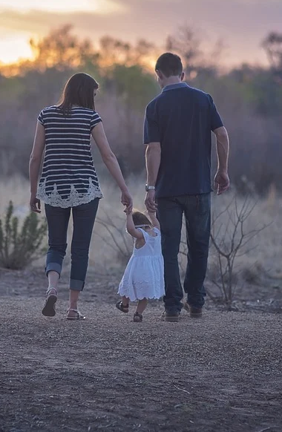
My Life Today…
Notes:
Add pictures that are about YOU

Slide 24
My Life Today…
Notes:
Add pictures that are about YOU

Slide 25
Where Are You On Your Journey?

Slide 26

Do Your Feel Like There’s More?

Slide 27

That Your Life Could Be Different?

Slide 28

That You Don’t Know Where to Start?

Slide 29

That You Are Unsure of Direction?

Slide 30

“I can't change the direction of the wind, but I can adjust my sails to always reach my destination.”

Slide 31
Your “WHY”

Slide 32
Are You Dissatisfied Now?

Slide 33
Are Your Ready and Excited to Learn the Process?

Slide 34
You DO NOT Need To Know How…
Notes:
ABC Goals, C goals, DON’T KNOW HOW

Slide 35
You DO NOT Need To Know How…
But you do need to know WHAT!
Notes:
Effect over principle.
With a “C type Goal it is exactly the same process.

Slide 36
The Only Prerequisite is DO YOU WANT IT?
Notes:
And the only prerequisite iS Do You WANT IT! DON’T NEED RESOURCES!!!! ONE OF THE BIGGEST ILLUSIONS THAT”S BEEN CREATED>>>>

Slide 37
Who Are You Taking Advice From?

Slide 38

Who Are You Learning From?
Speakers?

Slide 39

Who Are You Learning From?
Trainers?

Slide 40
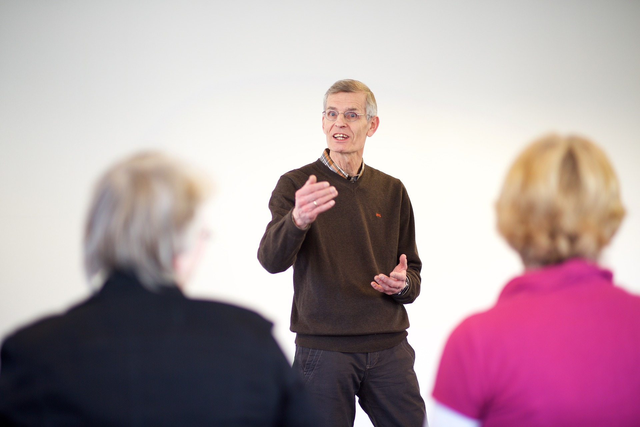
Who Are You Learning From?
Coaches?

Slide 41
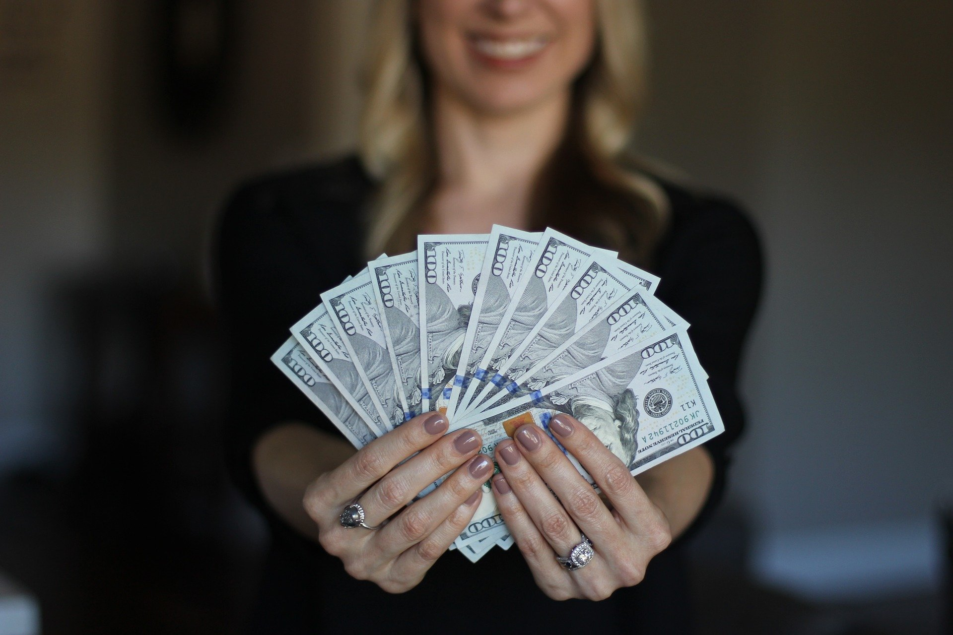
Who Are You Learning From?
Law of Attraction?

Slide 42

Or From Someone Who Has Done It?
Add a testimonial here about you
Notes:
Add a picture of yourself .. And a testimonial about working with you.

Slide 43
Here Are 3 Things to Get Started

Slide 44
INSERT SLIDES HERE TO TEACH A SHORT LESSON.
Plan for no more than 10 minutes for each section.

Slide 45

You Are A Spiritual Being

Slide 46

You Have A Marvelous Mind

Slide 47

You Live In A Physical Body

Slide 48

You Have the Ability to Grow

Slide 49

But You MUST Decide

Slide 50
A Question For You:
Wouldn't you agree that having an understanding of how to set the proper goals and understanding the science behind achieving them, has the potential to change EVERYTHING for you?

Slide 51
Wouldn’t You Agree That…
Integrating this into your life consistently will help you set and achieve goals, create clarity and unlock your life?

Slide 52
Wouldn’t You Agree That…
Even if you used a tiny fraction of what you learned today, hasn’t it been time well spend thus far? (lot more to come)

Slide 53
Would you like to spend more time together, going even deeper and further on how to create your life?

Slide 54
You Are Faced With 2 Choices
Notes:
Before we started I was faced with 2 choices:

Slide 55

You Are Faced With 2 Choices
Do it on your own time with own resources
Notes:
1 Hope that you took everything away and implemented on your own, on your own time and with your own resources.

Slide 56

You Are Faced With 2 Choices Today
Do it on your own time with own resources
We partner up and go at it together!

Slide 57

Your Offer Title Here
Introduce your offer. Your “offer” is you coaching session, your course, your program.
Your Link Goes Here
Notes:
LINK: Your call to action must ask them to do something. Go to your website = website link. Or Schedule A Call = calendar link.

Slide 58
Your Offer Title Here
Describe your offer or how you work together.
Your Link Goes Here

Slide 59
I Want You to Imagine …
Notes:
I want you to imagine

Slide 60

You continuously and confidently move towards new goals and dreams that are worthy of you, creating more value in your own life and in the lives of your loved ones in the process.

Slide 61

Creating thriving relationships that go well beyond the surface we’re so accustomed to

Slide 62

Living the life you’ve always wanted to live

Slide 63
“It doesn’t matter where you are, you are nowhere compared to where you can go. – Anders Hansen”

Slide 64
What’s the Value of …

Slide 65

…Unlocking the New Life Inside You

Slide 66

SUCCESS REQUIRES YOU TO TAKE ACTION
www.TheSecretToRealMagic.com

Slide 67

Because You Joined Me Today

Slide 68


SAMPLE BONUS THANK YOU
Notes:
Create something to give as a bonus for joining; and give them a link to go download it from your website.

Slide 69

Start Your New Life Now!
Your New Link Here
www.TheSecretToRealMagic.com

Slide 70

Your New Link Here
www.TheSecretToRealMagic.com

